Slide 1

Notes:
Pengshuo Liu

Slide 2


THE IDENTIFICATION OF
SPAM MAILS
Haoran Ding, MEng
Patrick Adjei, MEng
Pengshuo Liu, MEng
Zhaokai Sun, MEng
Data Analytics Foundations
Data Analytics Foundations
Notes:
Pengshuo Liu

Slide 3
Outline
Problem Description
Data Preparation
Algorithm Models
Results
Conclusion
Future Consideration
Data Analytics Foundations
Notes:
Pengshuo Liu

Slide 4
Problem Description
Data Analytics Foundations
Notes:
Pengshuo Liu

Slide 5
Overview
E-mail has become one of the most popular Internet services for instant and convenient message delivery. Unfortunately, e-mail also enables the spread of unsolicited and unwanted spam mail.
Spam email, also known as junk email, is unsolicited messages sent in bulk by email.
Data Analytics Foundations
Notes:
Pengshuo Liu

Slide 6
Effects of Spam
Problem Description
76% of the users who received spam responded that spam compromises their privacy.
Spam e-mail both directly and indirectly causes users to have privacy concerns.
Spam result in waste in allocated resource time.
Data Analytics Foundations
Notes:
Pengshuo Liu

Slide 7
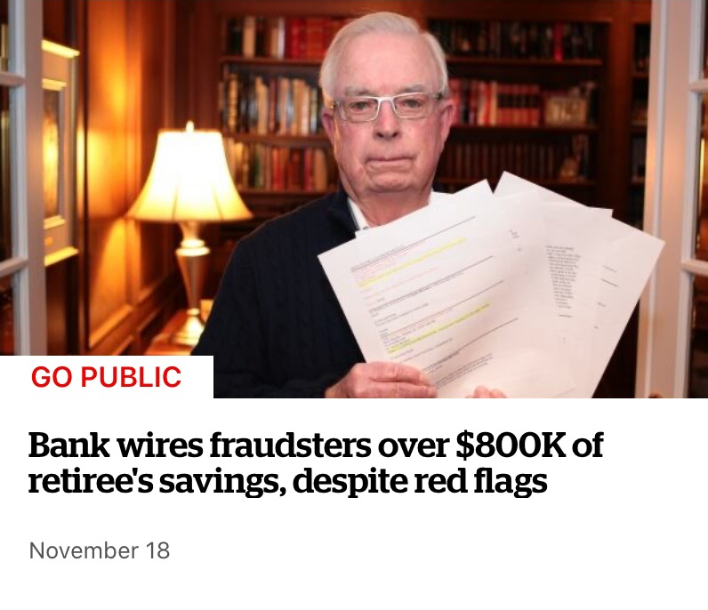
Effects of Spam
Case
“An email supposedly from the realtor handling the sale, said the balance should go to a different bank.”
--CBC News
Data Analytics Foundations
Notes:
Pengshuo Liu

Slide 8
Our goal
Accurately identify spam emails
Data Analytics Foundations
Notes:
Pengshuo Liu

Slide 9
Data Preparation
Data Analytics Foundations
Notes:
Next, I will talk about the data preparation part.

Slide 10
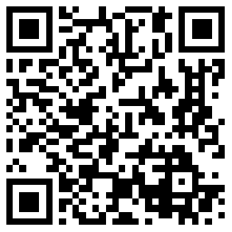
Data set introduction
Name: Spam Mails Dataset
Source: Kaggle
Column: 4
Row: 5171
Scan to download
Data Analytics Foundations
Notes:
First, let’s take an overall view at our data set.
The name of our dataset is Spam Mails Dataset, it can be download from Kaggle. And it has 4 columns and more than 5000 rows.

Slide 11
Sample Email
 | label | text | label_num
14 | ham | Subject: meter 1431 - nov 1999 aimee , sitara deal 92943 for meter 1431 has expired on oct 31 , 1999 . settlements is unable to draft an invoice for this deal . this deal either needs to be extended or a new deal needs to be set up . please let me know when this is resolved . we need it resolved by friday , dec 17 . hc | 0
Original serial number
→ Meaningless
Action: Delete
Mail label
→ Repeated
Action: Keep one
Data Analytics Foundations
Notes:
Then this is a sample of our data.
The first attribute is serial number.
The second attribute is the label of mail.
The third attribute is the mail text.
The fourth attribute is also the label of the mail.
So obviously the first attribute is meaningless, we will delete it.
And then the second and fourth attributes, they mean the same thing. So we will keep only one of them.

Slide 12
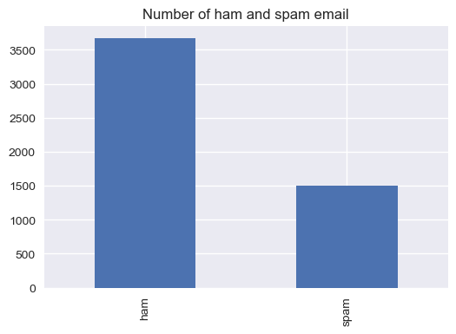
Data preparation
Ham : 3672
Spam: 1499
Data Analytics Foundations
Notes:
Then look at the ratio.
30% of the data is spam, and the rest 70% is ham.
This is the perfect ratio.
It means that we have enough data and don't have to worry about imbalance of training sets and test sets.

Slide 13
Data Cleaning
Subject: spring savings certificate - TAKE 30 % OFF
save 30 % when you use our customer appreciation spring savings certificate at foot-locker , lady foot-locker , kids foot-locker and at our online stores !
CASE SENSITIVE
→ Change all to lowercase
STOP WORD
→ Delete all
“the most common words in a language”
SYMBOL AND NUMBER
→ Delete all
USELESS
→ Delete All
“Bound to the format of the email”
Data Analytics Foundations
Notes:
Next step is the data cleaning.
This is a sample of the mail text. We will process some of words in it.
First let’s look at the yellow label. All these words are upper case We need to change them all to lower case.
Next, look at the red label. These words are called "stop words", it means the most common words in a language, like this, because, should, just. They have no meaning and we need to delete them.
Then the blue label. These are symbols and numbers. Again, delete all.
Next the green label. This "subject" appears at the beginning of the title of each email. Also have no meaning and we need to delete it.

Slide 14
Normalization
spring savings certificate save use customer appreciation spring savings certificate foot locker lady foot locker kids foot locker online stores
STEMMING
“shorten”
→ Change All
Ex:
Savings→save
appreciation →appreciate
LEMMATIZATION
“transform”
→ Change All
Ex:
lady →woman
kid→child
Notes:
After data cleaning, what we need to do is the normalization.
In the normalization work, there are two types of words:
First one is stemming. We need to shorten the words.
Second one is lemmatization. We need to turn these words into more common words.

Slide 15
Vectorizing
spring save certificate save use customer appreciate spring save certificate foot locker woman foot locker child foot locker online store
Features: Tokenized words delimited by space
TF-ID = TF(t,d) * IDF(t)
IDF =log(n) - log(df(d,t))
Data Analytics Foundations
Notes:
Next, my friend Patrick will explain the vectorization part.

Slide 16
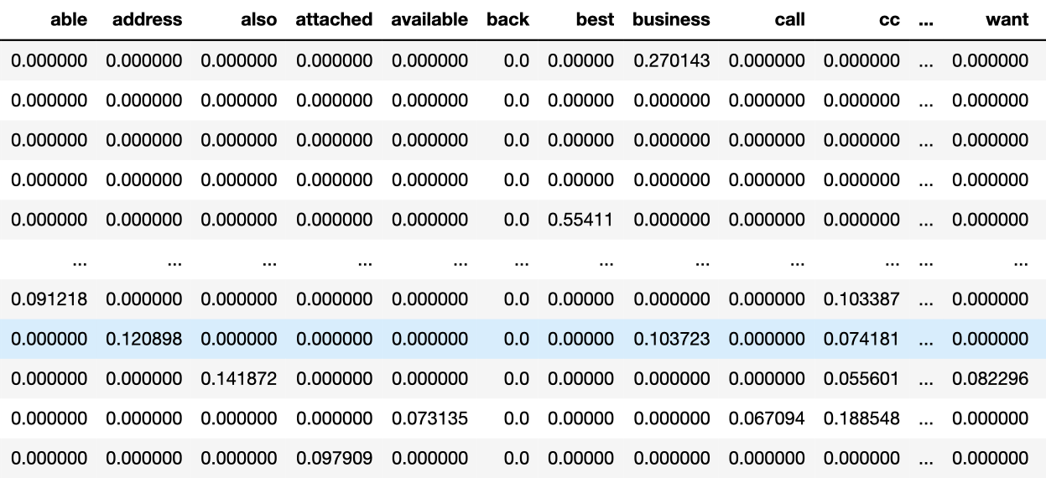
Vectorizing
Data Analytics Foundations
Notes:
Patrick Adjei

Slide 17
Algorithm Models
Data Analytics Foundations
Notes:
Haoran Ding

Slide 18
Model selection
Naive Bayesian
Random Forest
Decision Tree
SVM
Ensemble Learning
> Hard voting - Majority Vote
> Soft voting - Averaging out Probabilities
> Voting Classifier
LSTM
Data Analytics Foundations
Notes:
Haoran Ding

Slide 19
Results
Data Analytics Foundations
Notes:
Haoran Ding

Slide 20
Results
Receiver Operating Characteristic Curves
ROC Curves
True Positive Rate (TPR) vs False Positive Rate (FPR)
roc_curve function
Larger Area Under Curve, more accurate of result
Data Analytics Foundations
Notes:
Haoran Ding

Slide 21
Accuracy comparison
Naive Bayesian
Naive Bayesian
Random Forest
Random Forest
Decision Tree
Decision Tree
SVM
SVM
Ensemble Learning
Data Analytics Foundations
Notes:
Haoran Ding

Slide 22
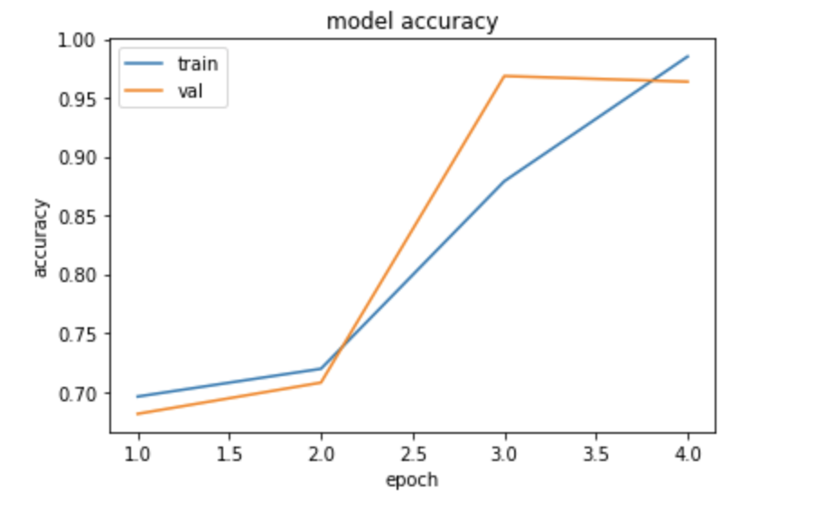
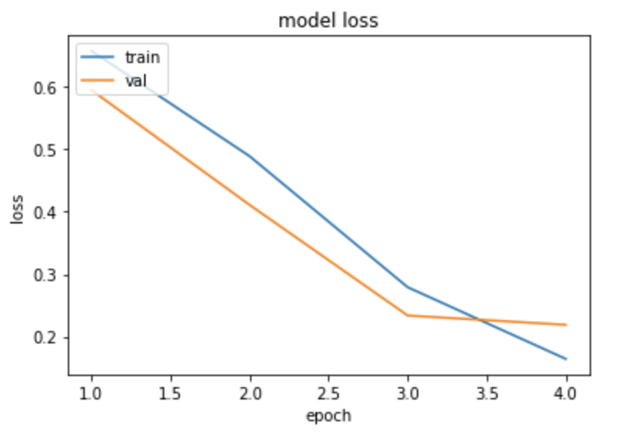
Accuracy comparison
LSTM
Data Analytics Foundations
Notes:
Haoran Ding

Slide 23
Accuracy summary
Model | Accuracy
Naive Bayesian | 92.7%
Random Forest | 96.0%
Decision Tree | 93.5%
SVM | 96.7%
Ensemble Learning | 96.3%
LSTM | 96.9%
Data Analytics Foundations
Notes:
Haoran Ding

Slide 24
Conclusion
Data Analytics Foundations
Notes:
Pengshuo Liu

Slide 25
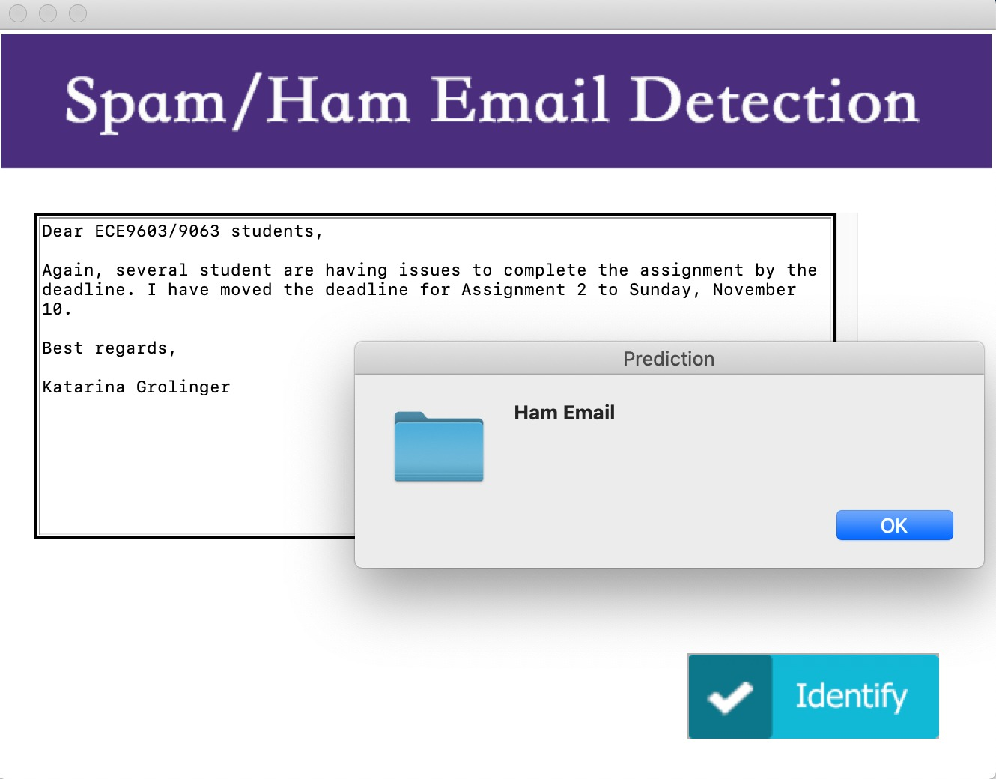
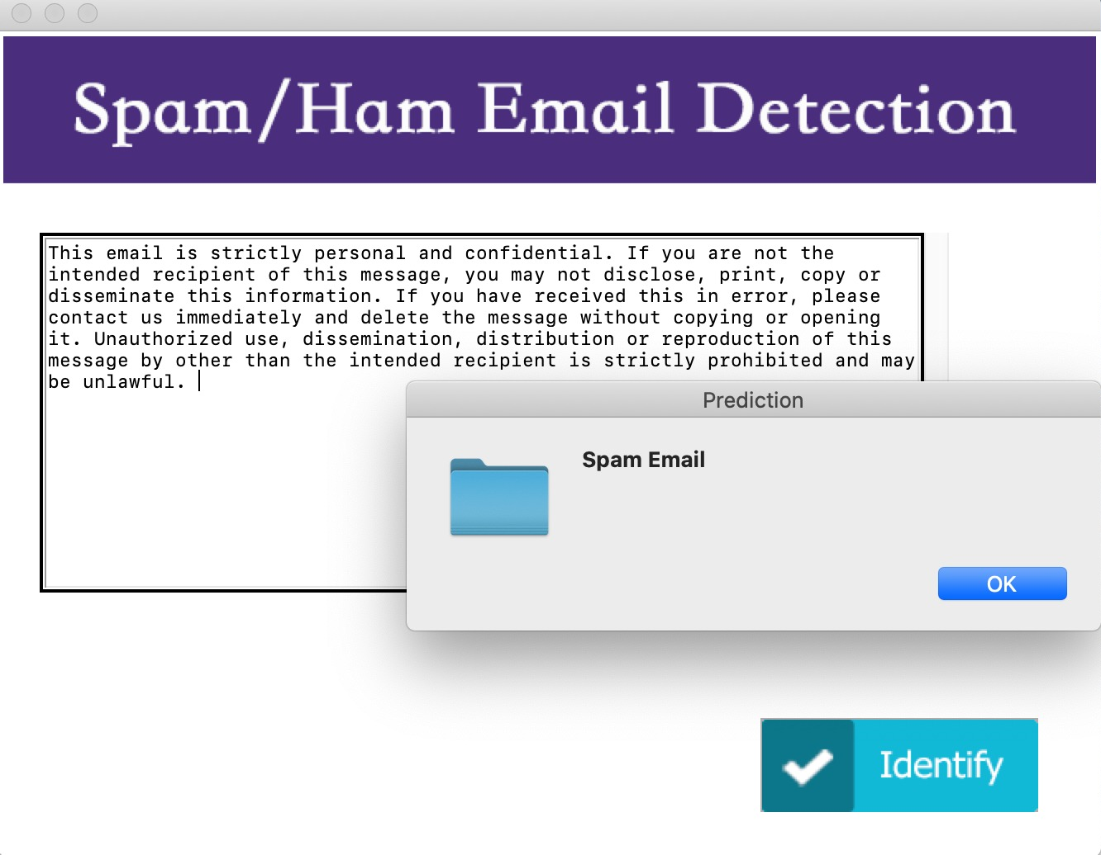
GUI Implementation
Spam mail
Spam mail
Ham mail
Data Analytics Foundations
Notes:
Pengshuo Liu

Slide 26
Conclusion
Advantages
Use proper data cleaning, normalization, vectoring to boost the efficiency of data preparation.
Practice different machine learning algorithms and ensemble learning to improve the performance of the model.
Implement a GUI to test real world emails.
Data Analytics Foundations
Notes:
Pengshuo Liu

Slide 27
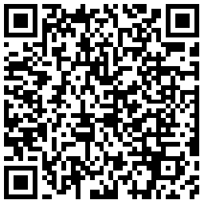
Conclusion
Disadvantages
Dataset could be bigger.
The label (spam or ham) is given manually, with strong personal preference.
“ AI judges will become racists if their machine learning samples are judged by racist judges. ”
Scan to read related news
Data Analytics Foundations
Notes:
Pengshuo Liu

Slide 28
Future Consideration
Data Analytics Foundations
Notes:
Patrick Adjei

Slide 29
Pre-processing
Subject: spring savings certificate - TAKE 30 % OFF
save 30 % when you use our customer appreciation spring savings certificate at foot-locker , lady foot-locker , kids foot-locker and at our online stores !
Subject: spring savings certificate - TAKE thirty percent OFF
save thirty percent when you use our customer appreciation spring savings certificate at foot-locker , lady foot-locker , kids foot-locker and at our online stores !
Data Analytics Foundations
Notes:
Patrick Adjei

Slide 30
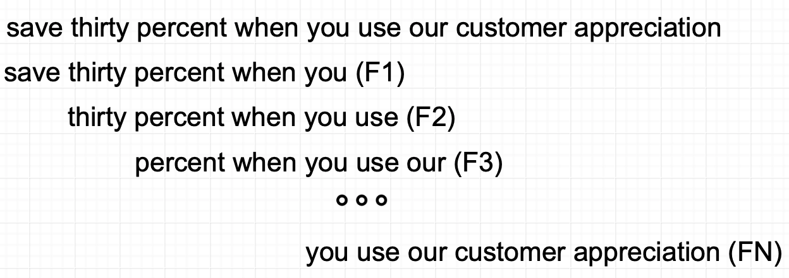
Vectorizing (NGram)
Data Analytics Foundations
Notes:
Patrick Adjei

Slide 31
Vectorizing (NGram)
Docs | F1 | F2 | F3 | FN
Doc 1 | 1 | 1 | 1 | 0
Doc 2 | 0 | 0 | 1 | 0
Doc N | 0 | 0 | 0 | 0
Data Analytics Foundations
Notes:
Patrick Adjei

Slide 32
Thanks
Data Analytics Foundations
Notes:
Patrick Adjei

Slide 33
Notes:
Patrick Adjei

